Slide 1

Buyer App
(Front end JS app)
Seller App
(Front end JS app)
Authentication
Shopping
Orders
Sitecore OrderCloud
Middleware
Tax Calculations
Payment
integrations
TTax
Payments
Other Integrations
……

Slide 2
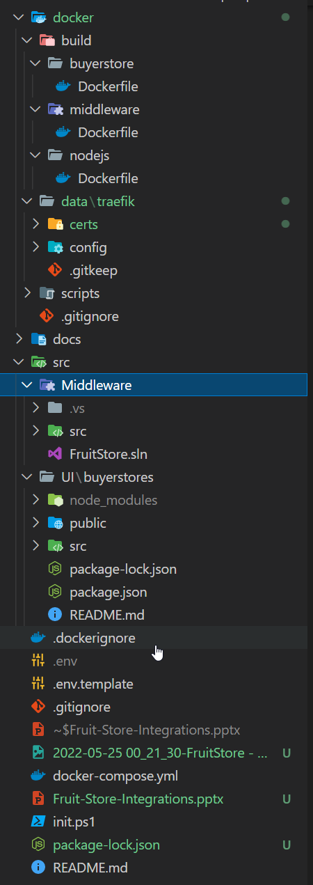
Docker compose files of different containers are here
In the data folder, the init.ps1 will create the required certs for this application
It has two folder- One for the dotnet core middleware and other for the front end Buyer and Seller applications

Slide 3
Fruit Store Organization
Buyer App
Buyer
Fruit Buyer
Buyer
Veg Buyer
Buyer Group
Default Fruit Store Buyers
User
Buyer User 1
User
Buyer User 2

Slide 4
Fruit Store Catalog
fs_catalog
Catagory
fresh_fruits
Product 1
Product 2
Product n
……

Slide 5
Navigation Data
Site
From SitecorePagePropsFactory as React Contexts
Header
…. ….
Footer

Slide 6
Site
Header Component
Header
Header data
getServerSideProps getStaticProps
…. ….
Footer Component
Footer
Footer Data
getServerSideProps getStaticProps

Slide 7

Good Luck
Ezhil…..!!!

